Slide 1

GNOME in Asia
BinLi
GNOME.Asia Committee

Slide 2

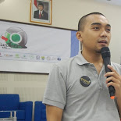


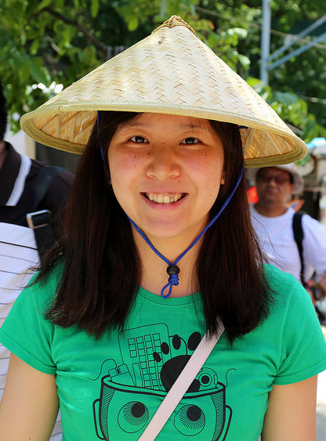

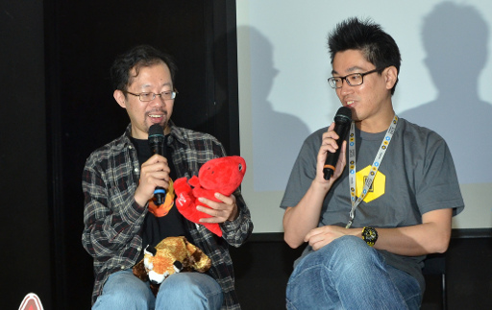
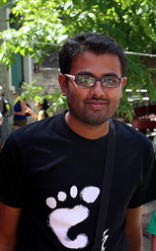
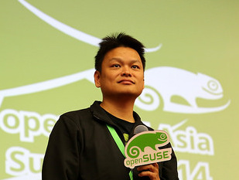
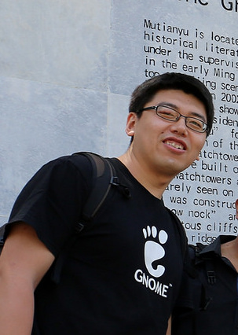
GNOME.Asia
Tobi
Utian
Will
Oliver
Emily
Haggen & Sammy
Anish
Max
Bin

Slide 3
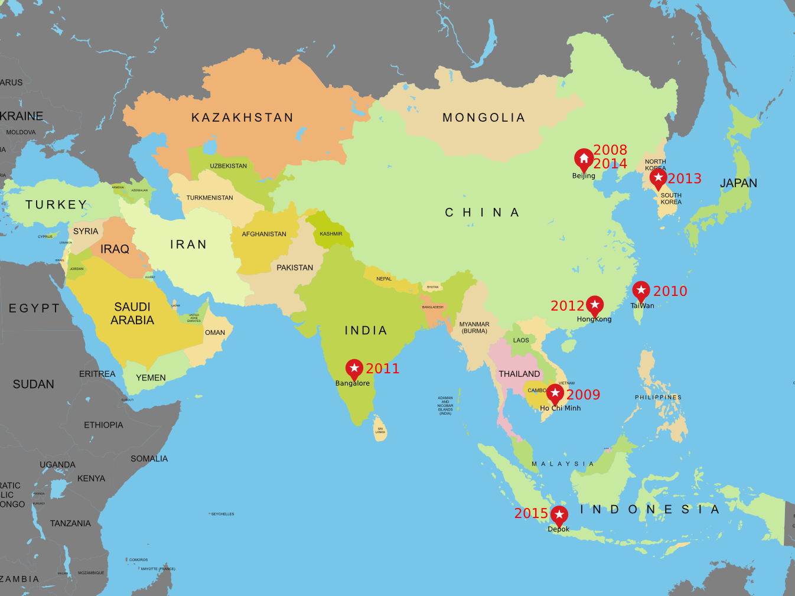


Slide 4
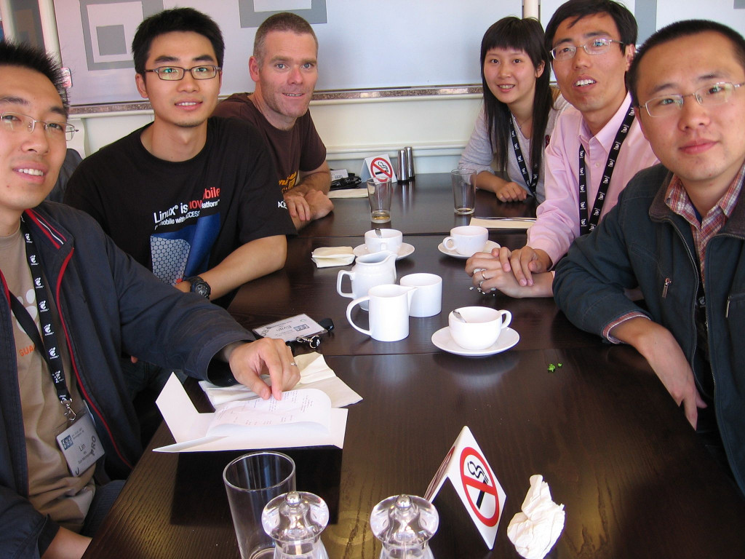
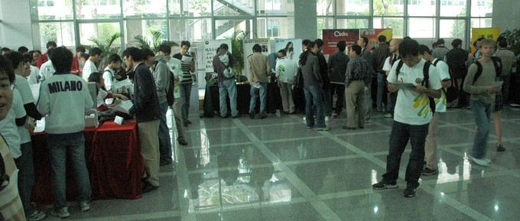

318 in 1st day
212 in 2nd day
46 volunteers
42 speakers
46 talks
7 booths at the venue:
Sun, Motorola, Mozilla, Red Hat, CSDN, Lemote, and the Beijing Linux Users Group.

Slide 6
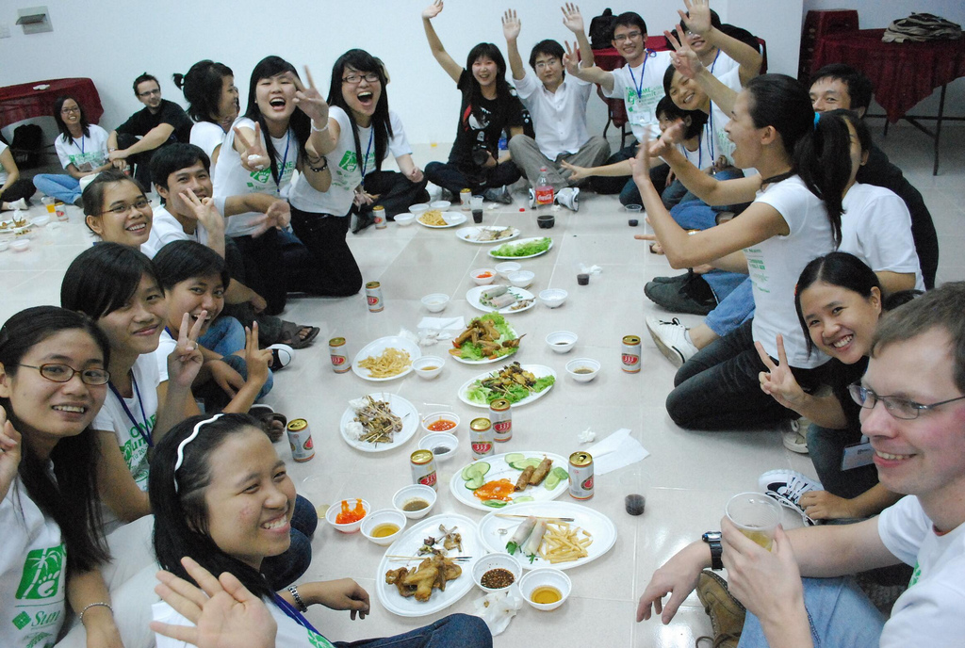
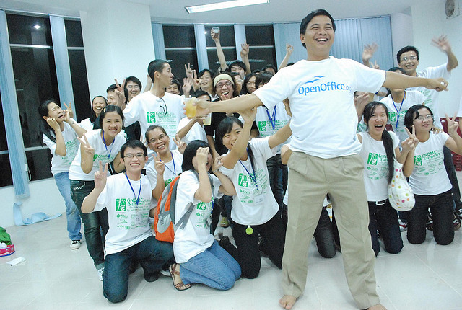
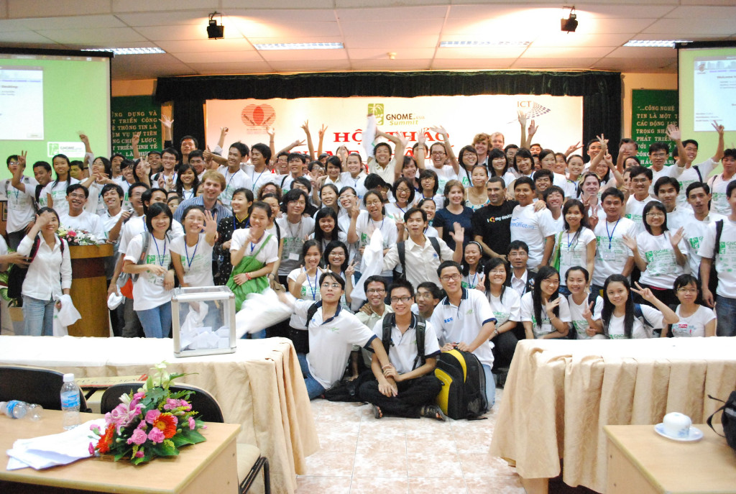

1465, 79 speakers, 109 talks

Slide 8

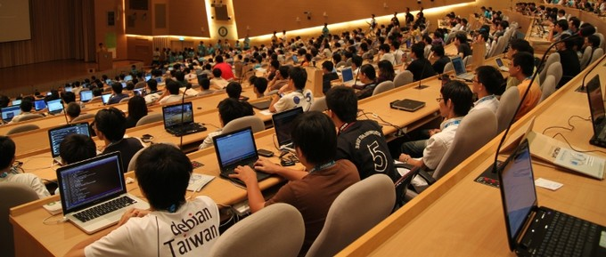

977 participants, 25 sponsors, 20 news outlets, 10 exhibitors

Slide 10
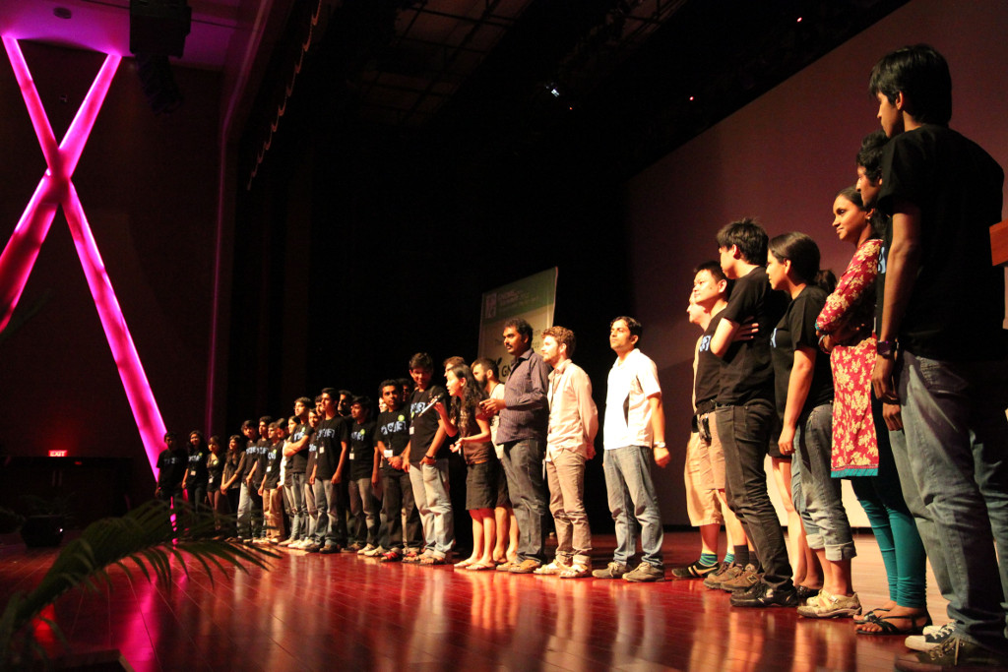

40 presentations, 30 speakers, 15 sponsors

Slide 12
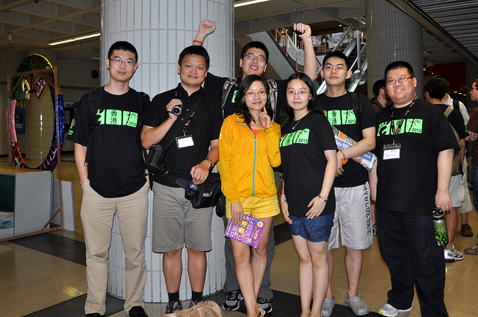
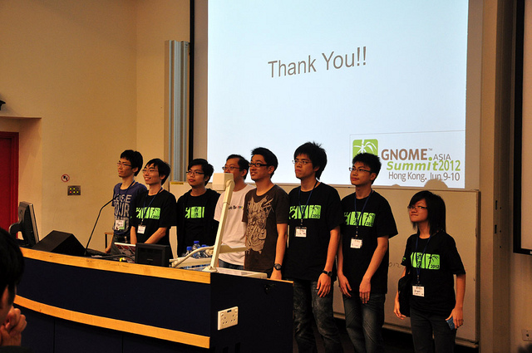
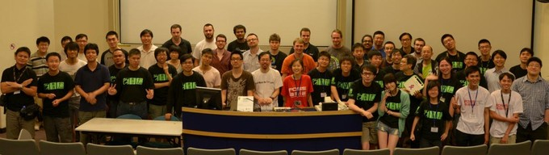

123 participants, 30 speakers

Slide 14
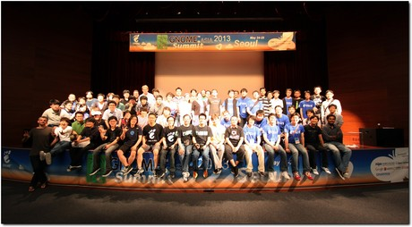
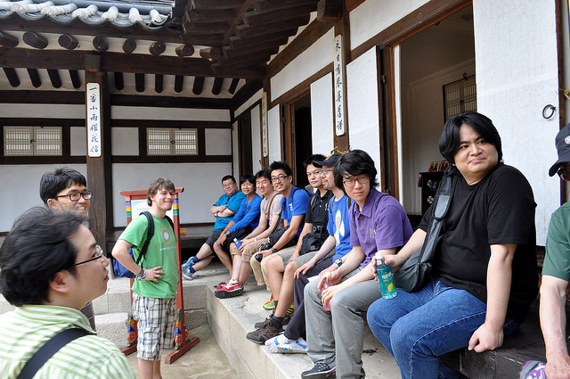
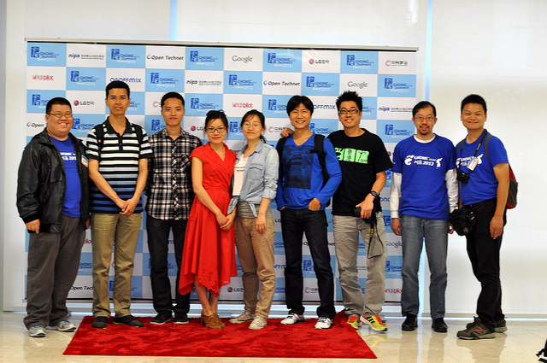

210 participant, 4 sponsor, 3 media partner

Slide 16
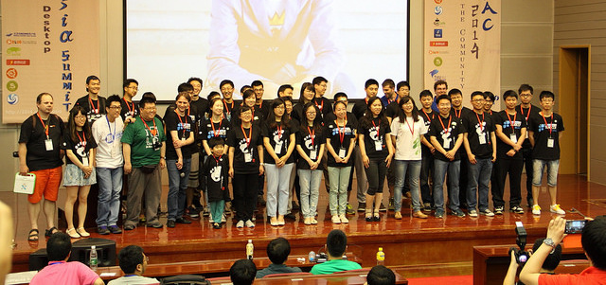
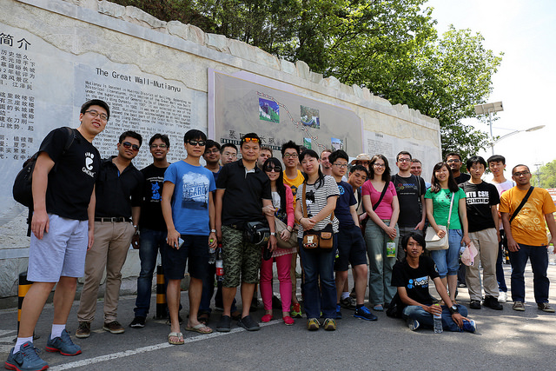
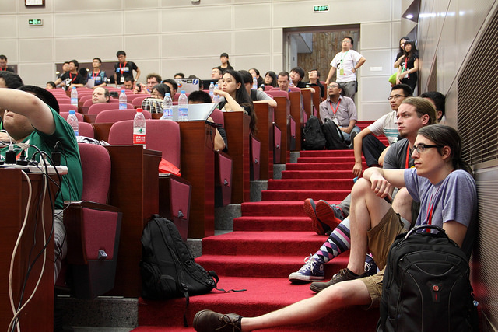

FUDCon
6 sponsors
50 volunteers
50 speakers
300 participants

Slide 18

http://2015.gnome.asia/register/

